Slide 1



Slide 2
Available Housing for PNP personnel in the Province of Isabela

Slide 3
VISTA DEL CIELO RESIDENCES
Brgy. Marabulig I, Cauayan City, Isabela
National Housing Authority in partnership with PBIG Fund
NATIONAL HOUSING AUTHORITY
Government Employees Housing Project (GEHP)
in partnership with
PAG-IBIG FUND
Countryside Housing Initiative Program (CHIP)

Slide 4
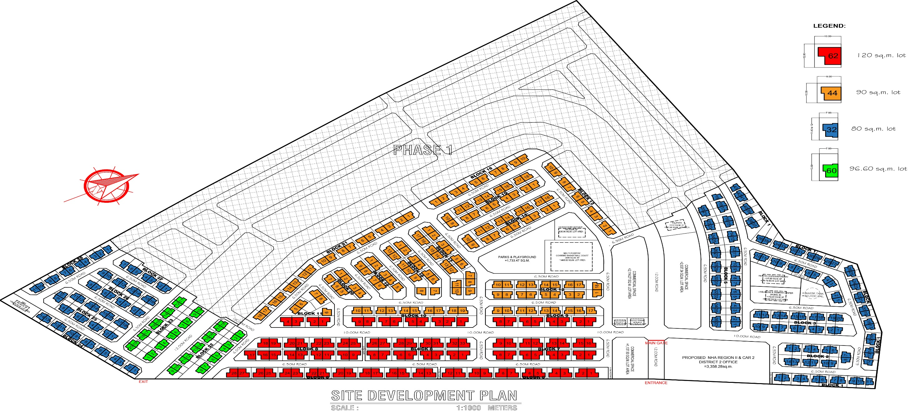

Slide 5
WHAT ARE QUALIFICATIONS?
Permanently employed in any branch of the government.
If already NHA awardee account should be up to date.
Not more than sixty-five (65) years old on the date of application and must not be more than 70 years old at the end of the housing loan.

Slide 6
WHAT ARE THE REQUIREMENTS?
1.1 Application to Purchase House and Lot/Unit Form
1.2 Overseas Employment Certificate (if OFW)
1.3 Proof of Income
1.4 Certificate of Active Service ( Uniformed Personnel)
- Employer’s Certificate of Compensation
- BIR Income Tax Return
1.5 Proof of Identity/Civil status
- For Single Applicants
Birth Certificate and two (2) valid IDs

Slide 7
WHAT ARE THE REQUIREMENTS?
For Married Applicants
Marriage Certificate
Affidavit of Separation-in-Fact (for applicants not
legally separated/annulled)
and two (2) valid IDs
1.6 Specific Program/Project Requirements if any.

Slide 8
WHAT ARE QUALIFICATIONS?
Permanently employed in any branch of the government.
If already NHA awardee account should be up to date.
Not more than sixty-five (65) years old on the date of application and must not be more than 70 years old at the end of the housing loan.

Slide 9
WHAT ARE THE REQUIREMENTS?
1.1 Application to Purchase House and Lot/Unit Form
1.2 Overseas Employment Certificate (if OFW)
1.3 Proof of Income
1.4 Certificate of Active Service ( Uniformed Personnel)
- Employer’s Certificate of Compensation
- BIR Income Tax Return
1.5 Proof of Identity/Civil status
- For Single Applicants
Birth Certificate and two (2) valid IDs

Slide 10
WHAT ARE THE REQUIREMENTS?
For Married Applicants
Marriage Certificate
Affidavit of Separation-in-Fact (for applicants not
legally separated/annulled)
and two (2) valid IDs
1.6 Specific Program/Project Requirements if any.

Slide 11
Thank you!!!

